Slide 1
Apache Kafka Tutorial

Slide 2
Topics For Today
Messaging Systems
Why Kafka
What is Kafka
Features of Kafka
Kafka Architecture
Kafka Terminologies
Kafka Components

Slide 3
What is Messaging?
Messaging is a method of communication between software components or applications.
A messaging system is a peer-to-peer facility: A messaging client can send messages to, and receive messages from any other client.
Each client connects to a messaging agent that provides facilities for creating, sending, receiving, and reading messages.
Distributed messaging is based on the concept of reliable message queuing. Messages are queued asynchronously between client applications and messaging system.
There are two types of messaging patterns. The first one is a point-to-point and the other one is “publish–subscribe” (pub-sub) messaging system.
Most of the messaging systems follow the pub-sub pattern.

Slide 4
Point to Point Messaging Systems
In a point-to-point system, messages are persisted in a queue. One or more consumers can consume the messages in the queue, but a particular message can be consumed by a maximum of one consumer only. Once a consumer reads a message in the queue, it disappears from that queue.
The typical example of this system is an Order Processing System, where each order will be processed by one Order Processor, but Multiple Order Processors can work as well at the same time.
Communication between two systems are done using Data Pipeline.
Data Pipeline
Publisher
Subscriber

Slide 5
Publish-Subscribe Messaging System
In the publish-subscribe system, messages are persisted in a topic. Unlike point-to-point system, consumers can subscribe to one or more topic and consume all the messages in that topic.
In the Publish-Subscribe system, message producers are called publishers and message consumers are called subscribers.
A real-life example is Dish TV, which publishes different channels like sports, movies, music, etc., and anyone can subscribe to their own set of channels and get them whenever their subscribed channels are available.

Slide 6
Publish-Subscribe Messaging
Publish/Subscribe pattern
Subscriber
Publish/Subscribe Channel
Publisher
Message
Subscriber
Subscriber

Slide 7
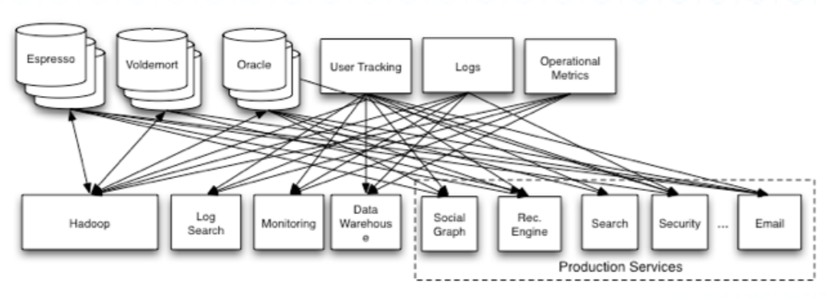
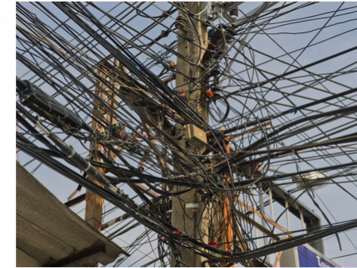
Real Time Complex Data Pipeline

Slide 8
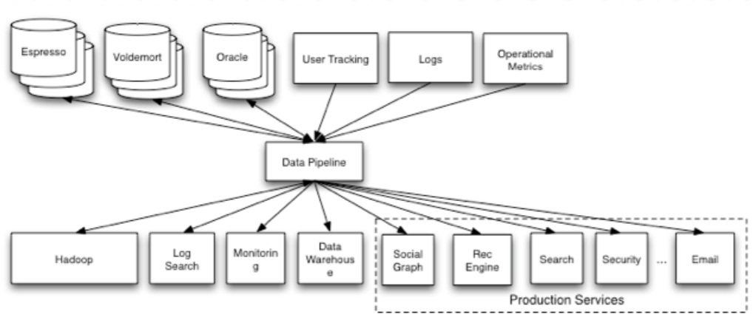
Complex Data Pipeline using Kafka

Slide 9
What is Kafka
Apache Kafka is a distributed publish-subscribe messaging system and a robust queue that can handle a high volume of data and enables you to pass messages from one end-point to another.
It was originally developed at LinkedIn and later became a part of Apache Project.
It is suitable for both offline and online message consumption. Kafka messages are persisted on the disk and replicated within the cluster to prevent data loss.
It is built on top of the Zookeeper synchronization service. It integrates very well with Apache Storm and Spark for real-time streaming data analysis.

Slide 10
Features of Kafka
High Throughput - Provides support for very large no of message with modest hardware support
Scalability
No Data loss if configured properly
Stream processing – can be used with Spark and Storm
Durability - Support of persisting message on disk
Replication - Message replication across cluster to support multiple consumers
Message Retention
Horizontally Scalable

Slide 11
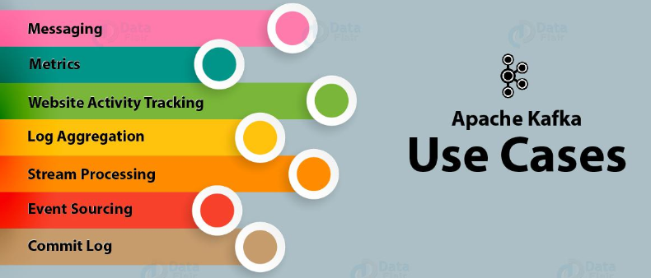
Kafka Use Cases

Slide 12
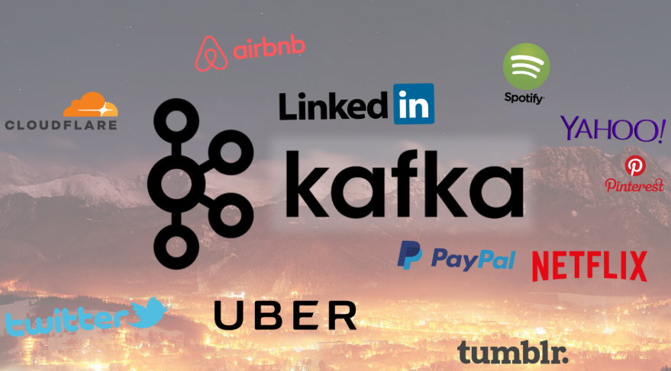
Kafka Applications

Slide 13
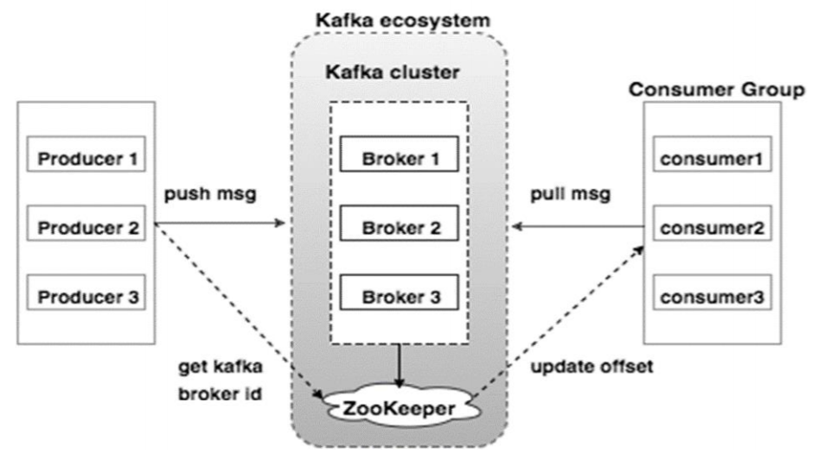
Kafka Architecture

Slide 14
Kafka Terminologies
Producer - Message publisher to a Topic
Consumer – Message consumer from a Topic
Partition – Topics are broken into ordered commit logs
Broker – A Kafka server
Topic - A category or feed name
Zookeeper – Managing/coordinating broker
Cluster - A set of server/broker
Consumer Group - Multiple consumer

Slide 15
Kafka Producer
Send records to the Topic
Picks partitions
Are not aware of any Consumer
Picks which partition to send the record to per Topic
Can be done in a round robin
Can be based on priority
Typically based on Key of a Record
Kafka default partitioner for java uses hash ok keys to choose partitions, or a round-robin strategy if no key present

Slide 16
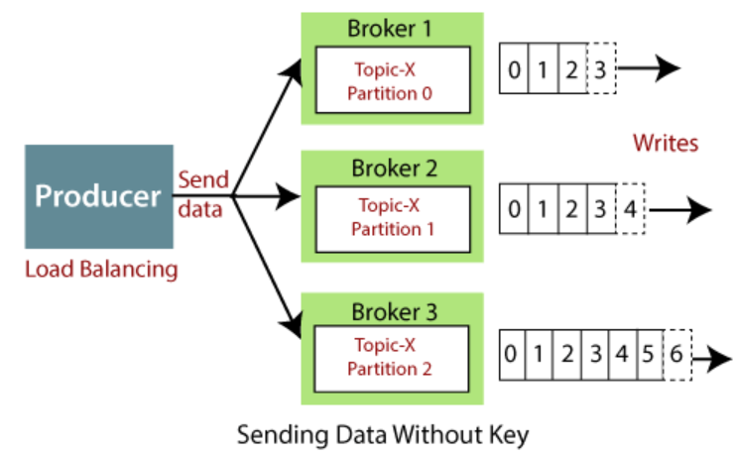
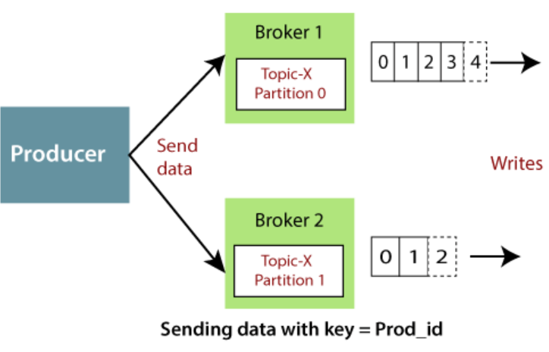
Kafka Producer Flow
Sending data Without key Sending data With key

Slide 17
Kafka Consumer and Consumer Group
An application that reads data from Kafka Topics.
Kafka Consumer subscribes to one or more topics in the Kafka cluster then further feeds on tokens or messages from the Kafka Topics.
Using Heartbeat we can know the connectivity of Consumer to Kafka Cluster.
We can group the consumers, and the consumers in the Consumer Group in Kafka could share the partitions of the Kafka Topics they subscribed to.
A consumer can easily read data from multiple brokers at the same time.
A consumer also knows that from which broker, it should read the data.
The consumer reads the data within each partition in an orderly manner.

Slide 18
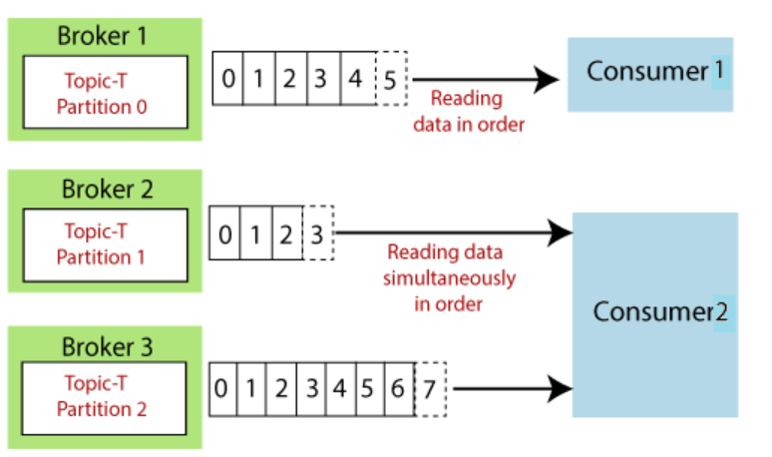
Kafka Consumer Flow

Slide 19
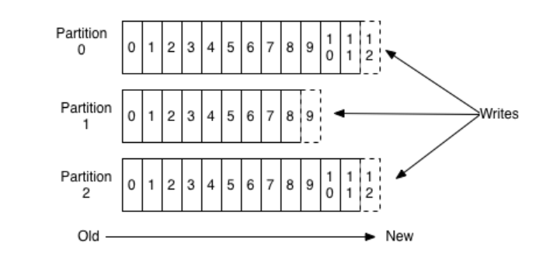
Kafka Topics and Partitions
A topic is a category or feed name to which records are published.
Topics in Kafka are always multi-subscriber.
For each topic, the Kafka cluster maintains a partitioned log as below:

Slide 20
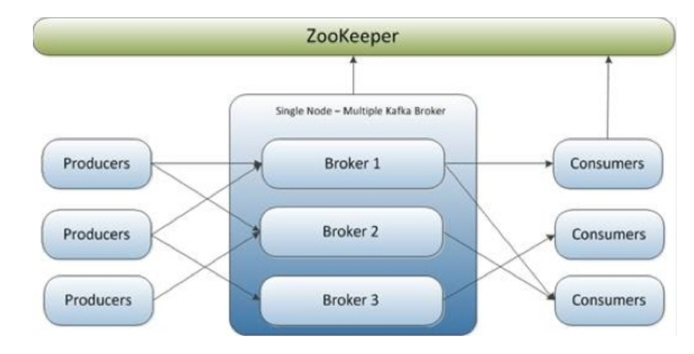
Kafka Broker/Cluster
A server which runs in Kafka Cluster.
Multiple Kafka brokers make a Kafka cluster.

Slide 21
Kafka Zookeeper
A centralized service and is used to maintain naming and configuration data and to provide flexible and robust synchronization within distributed systems.
Used for leadership election for Broker Topic Partition Leaders.
Keeps track of status of the Kafka cluster nodes, topics, partitions etc.
Allows multiple clients to perform simultaneous reads and writes and acts as a shared configuration service within the system.
The data within Zookeeper is divided across multiple collection of nodes and this is how it achieves its high availability and consistency.
In case a node fails, Zookeeper can perform instant failover migration.
The configuration regarding all the topics including the list of existing topics, the number of partitions for each topic, the location of all the replicas, list of configuration overrides for all topics and which node is the preferred leader, etc.

Slide 22
Thank You.

